Slide 1

OSCILLATORY MOTION CSPC 132
Presented By: Mr. Mark Ofori Nketia

Slide 2
What is Oscillatory Motion?
Oscillatory motion is defined as the to and fro motion of an object from its mean position. The ideal condition is that the object can be in oscillatory motion forever in the absence of friction but in the real world, this is not possible and the object has to settle into equilibrium

Slide 3
A brief history & contexts
The study of SHM started with Galileo’s pendulum experiments (1638, Two new sciences).
Huygens, Newton & others developed further analyses.
pendulum – clocks, seismometers
ALL vibrations and waves - sea waves, earthquakes, tides, orbits of planets and moons, water level in a pond, acoustics, AC circuits, electromagnetic waves, vibrations molecular and structural e.g. aircraft fuselage, musical instruments, bridges.

Slide 4
Simple Harmonic Motion
Simple harmonic motion (SHM) is a type of oscillatory motion which is defined for the particle moving along a straight line with an acceleration which is moving towards a fixed point on the line such that the magnitude is proportional to the distance from the fixed point.

Slide 5
For any simple mechanical harmonic system (system of the weight hung by the spring to the wall) that is displaced from its equilibrium position, a restoring force which obeys the Hooke’s law is required to restore the system back to equilibrium.

Slide 6
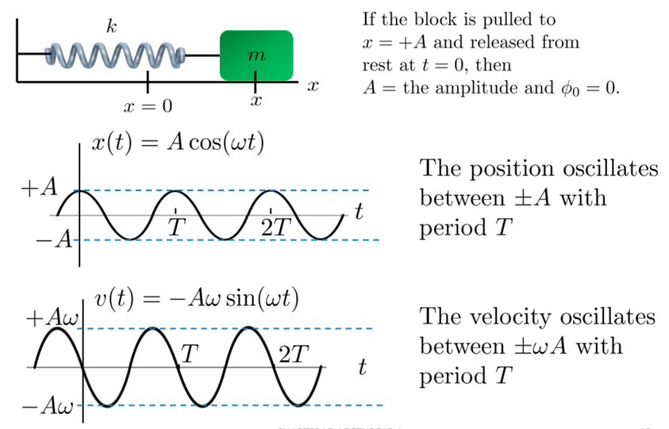
Describing SHM

Slide 7
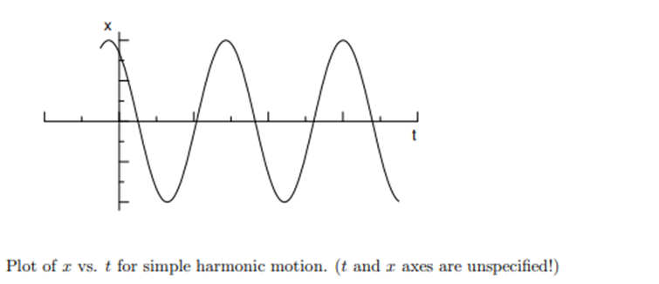
A graph of x vrs. t for this kind of motion is shown below. Suppose a particle has a periodic, sinusoidal motion on the x axis, and its motion takes it between x = +A and x = −A. Then the general expression for x(t) is
x(t) = A cos(ωt + φ)

Slide 8
A is called the amplitude of the motion.
ω is called the angular frequency.
the time t increases by an amount 2π
ω
So the motion repeats itself after a time interval 2π
ω
we denote as T , the period of the motion.
φ is the phase angle

Slide 9
The system goes through a recurring cycle.
Amplitude, A, is the maximum displacement.
If the cycle repeat time is independent of amplitude (the oscillations is isochronous), then you can define a periodic time, T, and frequency, f.
A restoring force tries to return system to equilibrium.
The system has inertia and overshoots equilibrium position.

Slide 10
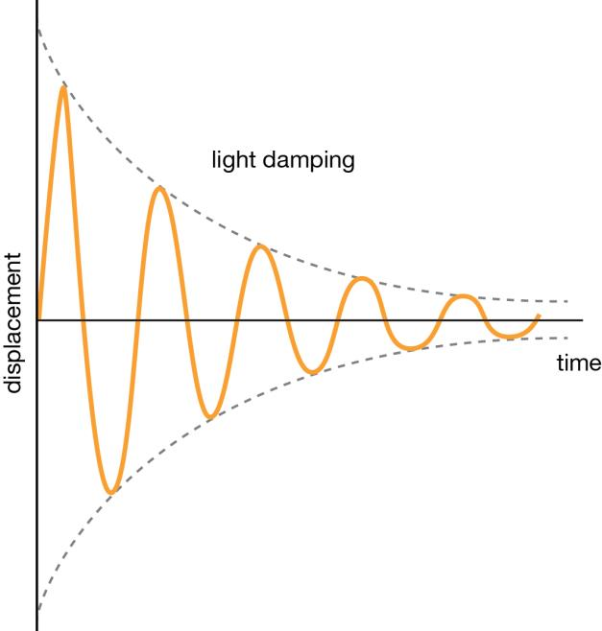
Damping
As a system loses energy, the amplitude falls.
Notes:
10

Slide 11
Trolley between springs
k is the constant relating restoring force to displacement, m is mass
The - sign indicates a and s have opposite directions.
The acceleration is
always directed towards the equilibrium position
proportional to displacement
Notes:
11
Advancing Physics graphic Motion of a harmonic oscillator

Slide 12
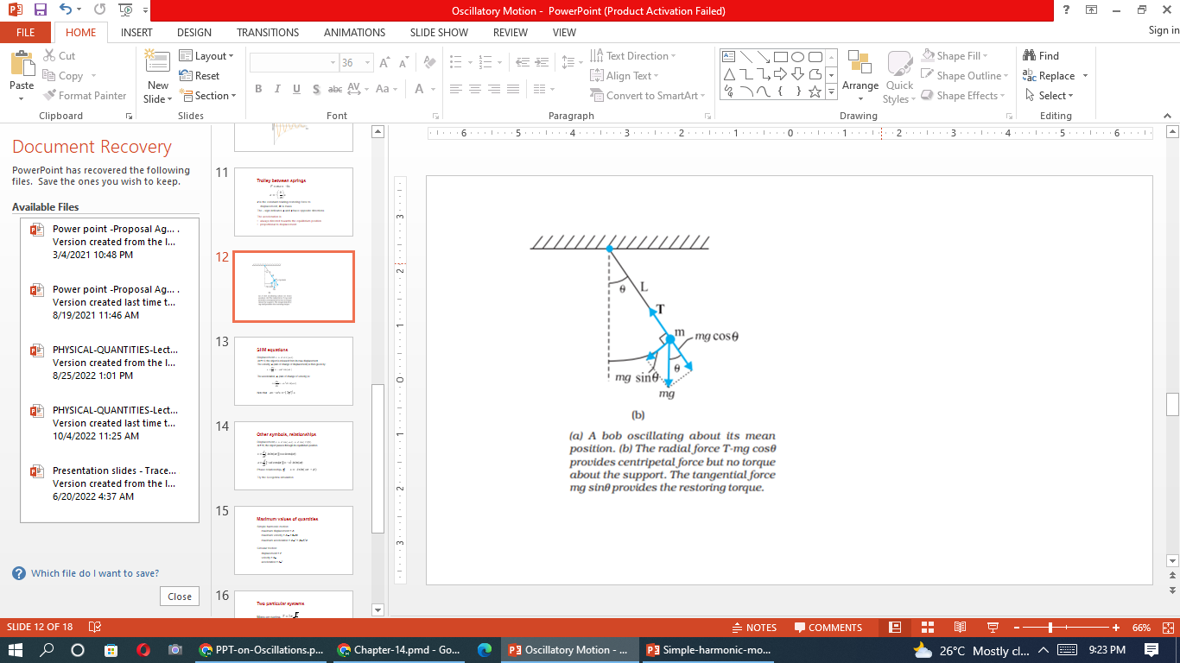

Slide 13
SHM equations
Displacement
At t = 0, the object is released from its max displacement.
The velocity, v, (rate of change of displacement) is then given by:
The acceleration, a, (rate of change of velocity) is:
Note that
Notes:
13

Slide 14
Other symbols, relationships
Displacement,
At t =0, the object passes through its equilibrium position.
Phase relationship, φ
Try the Geogebra simulation.
Notes:
14
http://slclondon.org.uk/files/SASP/ Simple Harmonic Motion.
14

Slide 15
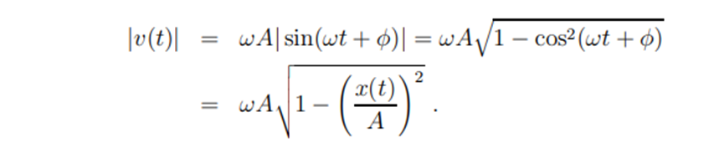

Slide 16
Maximum values of quantities
Simple harmonic motion:
maximum displacement = A
maximum velocity = Aω = 2πfA
maximum acceleration = Aω² = (2πf)²A
Circular motion:
displacement = r
velocity = rω
acceleration = rω²
Notes:
16

Slide 17
Two particular systems
Mass-on-spring,
Simple pendulum,
(for small angle oscillations)
Notes:
17

Slide 18
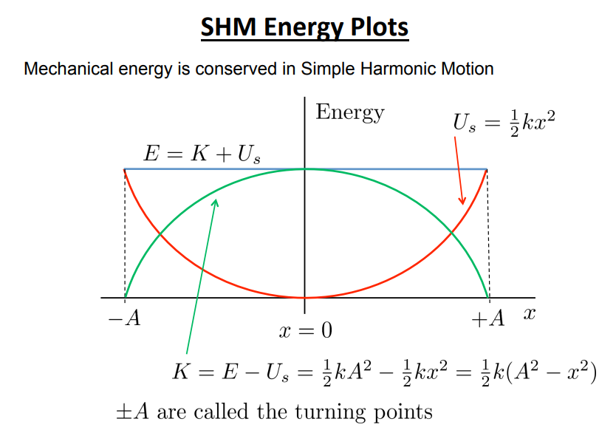

Slide 19
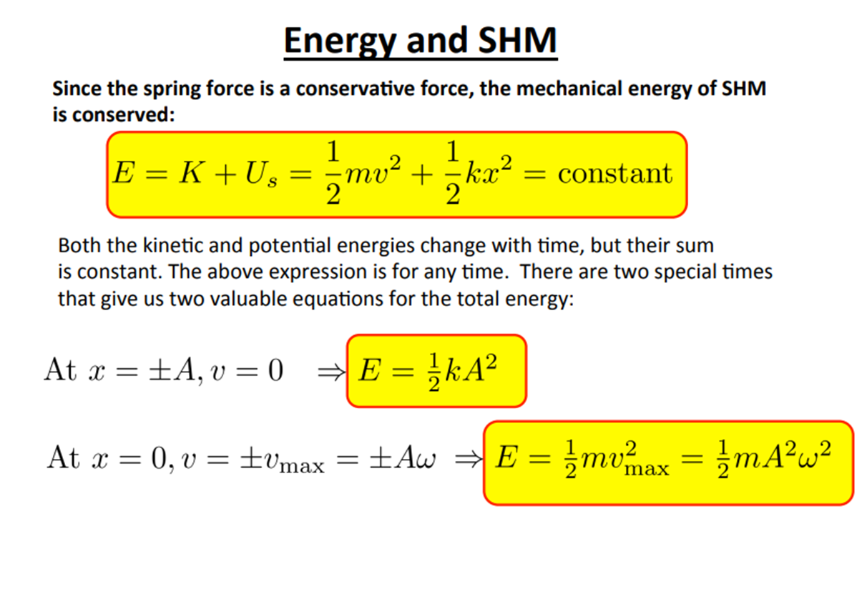

Slide 20
Example
A loudspeaker produces a musical sound by means of the oscillation of a diaphragm. If the amplitude of oscillation is limited to 1.0 × 10−3 mm, what frequencies will result in the magnitude of the diaphragm’s acceleration exceeding g?

Slide 21
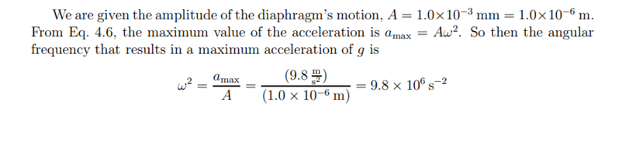

Slide 22
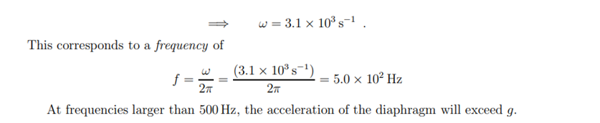

Slide 23
Example:
The scale of a spring balance that reads from 0 to 15.0 kg is 12.0 cm long. A package suspended from the balance is found to oscillate vertically with a frequency of 2.00 Hz.
(a) What is the spring constant?
(b) How much does the package weigh?

Slide 24
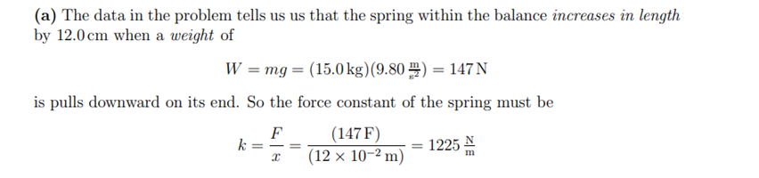

Slide 25
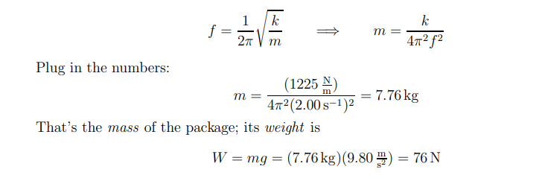
B) the frequency of oscillation of the mass–spring system in terms of the spring constant and the attached mass. We have the frequency and spring constant and we can solve to get the mass of the package:

Slide 26
Question
A simple pendulum has a period of 2.50 s. (a) What is its length? (b) What would its period be on the Moon, where gMoon = 1.67 m /s2

Slide 27
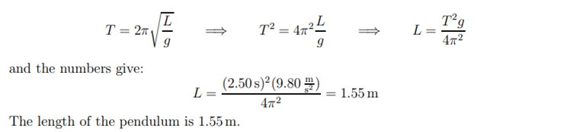
A) we solve for the length:

Slide 28
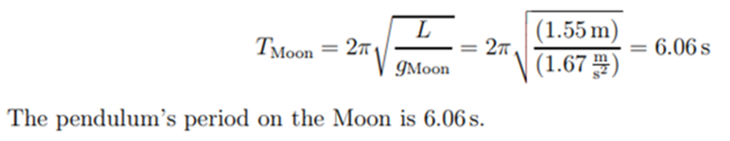
b) If we take this pendulum to the Moon, its length will be the same, but the acceleration of gravity will be different. Using the new value of g, we find

Slide 29
Thank you

